Slide 1
Consultants
Michelle Swartz, MSW, LISW-S
IECMHC Lead
Butler, Clermont
mswartz@ccswoh.org
Mary Guy, BS
IECMHC Hamilton
mguy@ccswoh.org
Stacy Dixon, BS
IECMHC
Warren,Clinton

Slide 2
Early Childhood Plus consultants have extensive experience and knowledge in
social emotional development,
child development,
trauma and mental health.

Slide 5
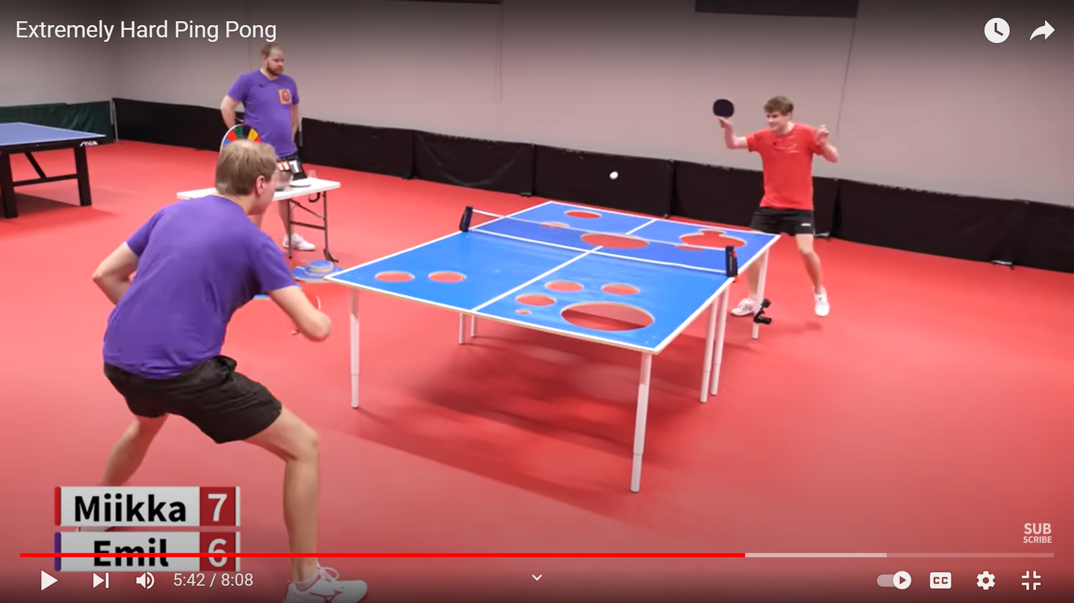

Slide 6
Menti-meter

Slide 7
The Child Care Resource and Referral (CCR&R) project is a statewide initiative in which IECMHC support the work of child care resource and referral agencies.
GOAL of the project is to promote adult and child resilience and wellness.
STRENGTHEN capacity of CCR&R staff to respond to the challenges of providers, caregivers and children.
COLLABORATE with CCR&Rs to best meet their needs.

Slide 8
CCR&R Agency- Supports
✔ Provide training and professional development to promote agency goals
✔ Gather data and report it to the state to encourage data-driven decision making
✔ Share tools and resources with staff
✔ Attend staff meetings to provide a mental health perspective
✔ Facilitate a positive environment through team building and engagement

Slide 9
CCR&R Staff Supports
CCR&R STAFF
✔ Offer MONTHLY office hours to consult on challenging cases
✔ Meet with staff individually or in groups to foster use of mental health resources
✔ Research best-practices in response to specific challenges
✔ Facilitate reflective practice in which staff consider strategies used

Slide 10
CCR&R Providers, Families and Children
✔ Accompany CCR&R staff to sessions with partner providers or families to conduct observation and assessment
✔ Develop a focused plan in collaboration with CCR&R staff regarding specific partner provider or caregivers/children
✔ Accept short-term referrals from CCR&R staff to provide consultation to: • Staff • Partner providers • Caregivers/family
✔ Provide short-term consultation

